Slide 1
Radial-Basis Function Networks
CSE301 Bio-computation, Week 8
Nov 7, 2016
Bailing Zhang

Slide 2
Introduction
The most common tasks performed by neural networks are classification and prediction. This categorization has historical significance as well.
These tasks involve input-output mappings, and the network is designed to learn the mapping from knowledge of the problem environment.
Thus, the design of a neural network can be viewed as a curve-fitting or function approximation problem.
  This viewpoint is the motivation for radial-basis function networks

Slide 3
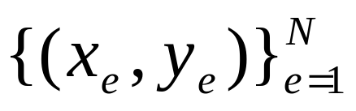

The Interpolation Problem
For the problem of curve-fitting (approximation in high-dimensional spaces) learning is equivalent to finding an interpolating surface in the multidimensional space that provides a best fit to the training data, measured by preselected statistical criteria.
The curve-fitting or interpolation problem can be stated as follows:
Given a set of examples find a function F:
R^{N}→ R¹ that satisfies the interpolation condition:
for each e=1,2,...,N.

Slide 4
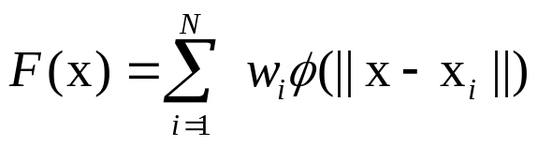

Radial-Basis Functions
The radial-basis functions technique suggests constructing of interpolation functions F of the following form:
where: is a set of nonlinear radial-basis functions, x_{i} are the centers of these functions, and ||•|| is the Euclidean norm.
A radial basis function (RBF) is a real-valued function whose value depends only on the distance from the origin, so that ; or alternatively on the distance from some other point c, called a center, so that . Any function that satisfies the property is a radial function

Slide 5
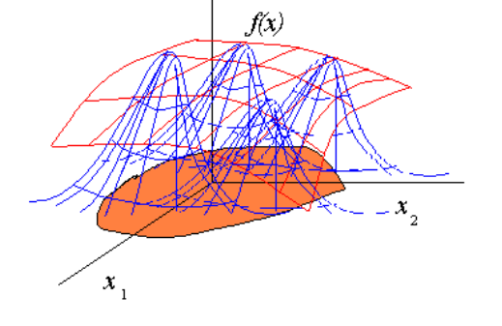

Slide 6
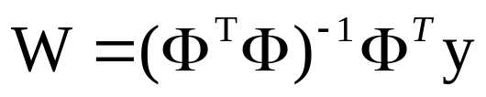

Radial-Basis Functions
The unknown weights can be found by solving the following linear matrix equation:
where: w is the weight vector, y is the response vector, and
is the design matrix

Slide 7
Radial-Basis Functions
Several widely used basis functions are:
  multiquadratics:
  φ( x ) = ( x² + c² )^{1/2} for some c>0
  inverse multiquadratics:
  φ( x ) = 1 / ( x² + c² )^{1/2} for some c>0
  Gaussian:
  φ( x ) = exp( - x² / 2σ² ) for some σ>0

Slide 8
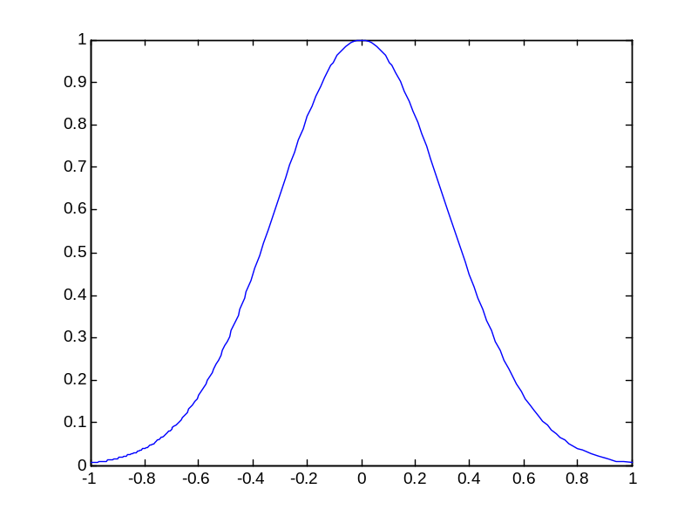

A Gaussian Function
A Gaussian RBF monotonically
decreases with distance from the center. Gaussian-­like RBFs are local (give a significant response only in a neighborhood near the center) and are more commonly used.
They are also more biologically plausible because their response is finite.

Slide 9
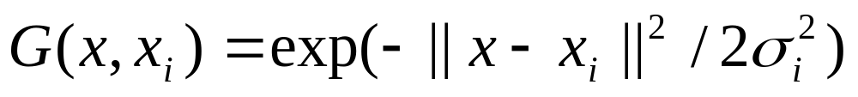
Radial-Basis Functions
The multivariate Gaussian function provides also two important properties that make it a proper choice for building radial-basis functions:
  it is both translation and rotation invariant.
The multivariate Gaussian function with these properties is called also Green's function:

Slide 10
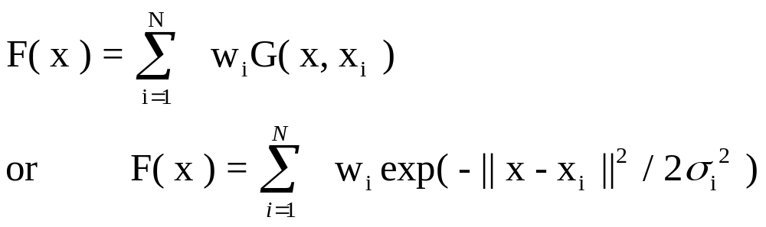
Regularization Networks
The regularization network models the interpolation function F as a linear superposition of multivariate Gaussian functions, which number is equal to the number of the given input examples N:
where: w_{i} are the weights.

Slide 11
Regularization Networks
Three important characteristics guaranteed:
it is a universal approximator in that it can approximate arbitrarily well any multivariate continuous function on a compact set, given a sufficiently large number of units;
it has the best approximation property in that given an unknown nonlinear function there always exists a choice of coefficients that approximates the function better than all other choices;
it produces optimal solutions that minimize the functional which measures how much the solution deviates from its true value as represented by the training examples.

Slide 12
The code for exact interpolation
% Interpolation data with basis functions
width=0.1; % the width of Gaussian RBF for exact interpolation
% width=0.4; % the width of Gaussian RBF for a simple RBFNN
x=[-1:0.1:1]; % the input data points
N=size(x,2); % the number of data points
f=sin(pi*x); % the clean target value
t=f+0.2*randn(1,N); % the noise target value
M=N; % the number of basis functions for exact interpolation
% M=4; % the number of basis functions for a simple RBFNN
c=zeros(1,M); % initializing the RBF centers
basis_matrix=zeros(M,N); % initializeing the RBF matrix, \phi_j^n
for j=1:M
c(j)=x(j); % for exact interpolation
% center=round(rand(1)*20+1); % for RBFNN
% c(j)=x(center); % for RBFNN
basis_matrix(j,:)=exp(-0.5*(x-c(j)).*(x-c(j))./(width*width));
% the value of basis functions
end
v=2.5*eye(M); % the weight_decay regularization matrix
% w=t/(basis_matrix+v); % including regularization
w=t/basis_matrix; % without regularization
x_test=[-1:0.01:1]; % the testing data
for j=1:M
test_matrix(j,:)=exp(-0.5*(x_test-c(j)).*(x_test-c(j))./(width*width));
% plot(x_test,w(j)*test_matrix(j,:)); % plot the weighted basis functions
% hold on;
end
y=w*test_matrix; % the learned function
plot(x,f,'k-',x,t,'ko',x_test,y); % plotting the result

Slide 13
Problems with the Regularization Networks
The one-to-one correspondence between the number of Green functions and the number of the training examples often become computationally inefficient, in the sense that it may require combining a very large number of basis functions (since often a large number of training examples are provided).
In practical situations finding of the linear basis function weights needs to invert very large Φ ^{T}Φ matrices, which may be ill-conditioned.
In order to avoid such problems the network topology should be reduced.
this means that we will attempt to find a solution that approximates the solution produced by the regularization network.

Slide 14
RBF Network Structure
An RBF network architecture consists of 3 layers:
- input layer: which passes the example vectors to the next layers
- hidden layer: applies a non-linear transformation function to the inputs, and expands them in the usually very high-dimensional hidden space
- output layer: applies a linear transformation to the given vector
Note, however, that sometimes RBF is called one-layer network as it has only one hidden layer!

Slide 15



Radial Basis Function Network
_{ϕ}
₍
_{X}
₎
_{X}
₁
_{w}
₁
_{x1}
_{ϕ}
_{m}
_{i}
₂
₍
_{X}
₎
_{y}
₌
∑
_{w}
_{ϕ}
₍
_{X}
₎
_{w}
₂
_{i}
_{i}
_{x2}
_{i}
₌
₁
Output
_{w}
₃
∑
y
_{x3}
_{ϕ}
₍
_{X}
₎
₃
...
_{w}
_{m}
...
₁
_{x}
More likely to be linearly separated
_{N}
_{ϕ}
₍
_{X}
₎
_{m}
₁
_{Increased dimension:}
_{N->m1}
_{ϕ}
₍
_{X}
₎
:
_{non}
_{linear}
_{function}
_{i}
Hidden layer: applies a non-linear transformation from the input space to the hidden space.
Output layer: applies a linear transformation from the hidden space to the output space.

Slide 16
RBF Network: the Rationale
The rationale behind RBF is that when the examples are cast in higher-dimensional space they are more likely to be linearly separable there than in a lower-dimensional space.
  This is also the starting point of other Kernel Methods
A nonlinear function can be taken to transform a difficult nonlinear interpolation problem into an easier one that involves linear mapping.
That is why, the RBF networks are designed to perform nonlinear mappings from the input space to the hidden space, and next a linear mapping from the hidden space to the output space.

Slide 17
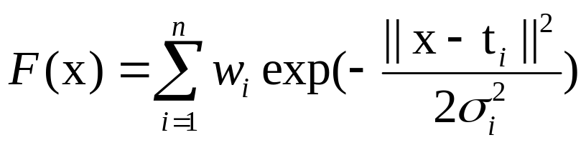
Function Mapping by RBF Networks
The radial-basis function network models the interpolation function F as a linear superposition of a finite number of multivariate Gaussians as follows:
where: w_{i} are the weights, and the number of basis functions n is less than the number of points in the training set n < N.
The basis function centers t_{i} are determined in advance.

Slide 18


RBF Learning (I)
Weights can be computed by the pseudo-inverse method.
For an example , consider the output of the network
We would like for each example, that is
This can be re-written in matrix form for one example

Slide 19
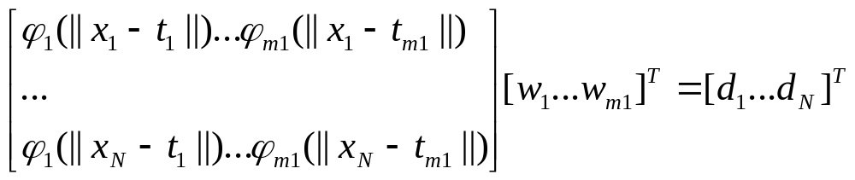
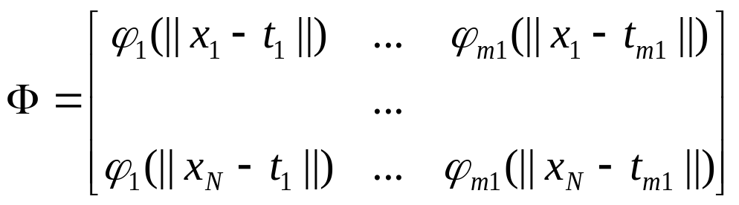
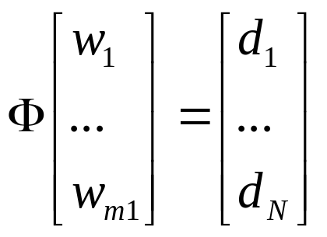
RBF Learning
and
for all the examples at the same time.
_{Let}
then we can write

Slide 20
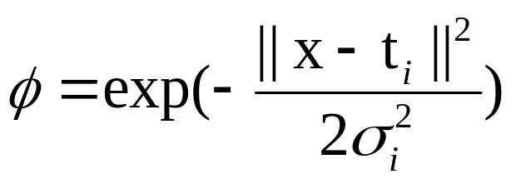
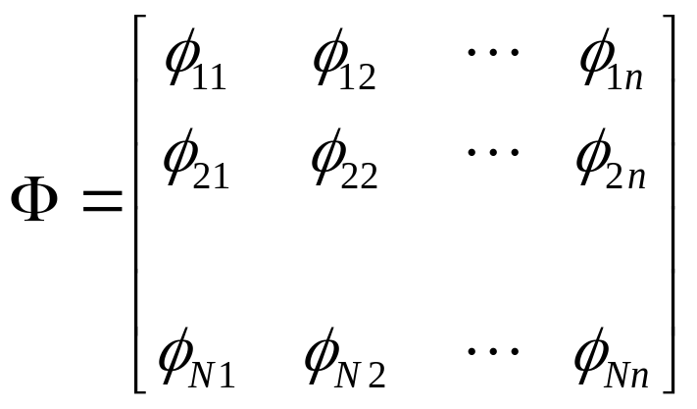
RBF Learning
Φ is the nxn design matrix of basis functions

Slide 21


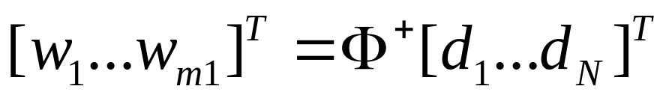
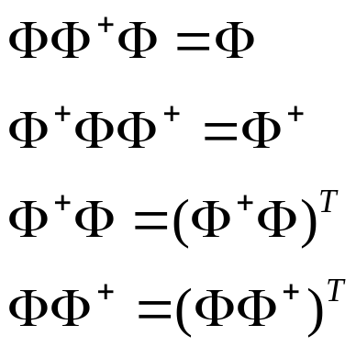
RBF Learning
If is the pseudo-inverse of the matrix we obtain the weights using the following formula
Pseudo inverse
has a unique pseudo-inverse
satisfying the conditions:

Slide 22
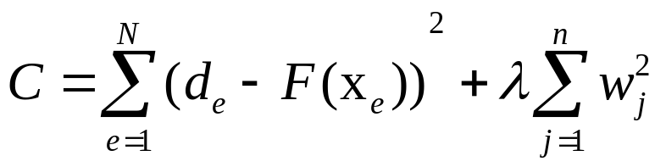
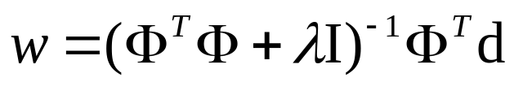
RBF Learning (II)
Learning of the network weights w_{i} can also be stated as an optimization problem with following cost functional:
where: λ is a regularization parameter.
Then the weight vector solution is given by the normal equation:
where: I is nxn identity matrix which elements are all zero except these on the diagonal
d is the output vector given with the examples

Slide 23
RBF Training Algorithm
Initialization: Examples {( x_{e}, d_{e} )}_{e=1}^{N}
Determine:
  - the network structure with a number n of basis functions φ_{i}, i=1,2,...,n
  - the basis function centers t_{i}, i=1,2,...,m ( using for example the k-means clustering algorithm )
  - the basis function variances σ_{i}², i=1,2,...,m ( by setting σ_{i}² equal to the average Euclidean distance from t_{i} to its 5 nearest neighbors )

Slide 24
RBF Training Algorithm
calculate the outputs from each e^{th} example with the Gaussian basis functions:
φ_{ei} = exp( - || x_{e} - t_{i} ||² / 2σ_{i}² ) // at each ith hidden unit
where i=1,2,...,n; e=1,2,...,N
compute the correlation matrix: Φ^{T}Φ , and perform:
Φ^{T}Φ + λI
  - invert the matrix: (Φ^{T}Φ + λI) ⁻¹
  - compute the vector: Φ^{T} d
  - estimate and the weights: w = (Φ^{T}Φ + λI) ⁻¹ Φ^{T} d
The radial-basis function centers t_{i} and variances σ_{i}² may be trained
along with the output weights but this takes a long time. That is why,
they are often determined in advance.

Slide 25
Matlab 7.0 Neural Network Toolbox
>> radbasis
Radial basis networks.
For information on these networks and the functions they
use, see the following functions:
newrb - Design a radial basis network.
newrbe - Design an exact radial basis network.
newgrnn - Design a generalized regression neural network.
newpnn - Design a probabilistic neural network.

Slide 26
Matlab 7.0 Neural Network Toolbox
>> help newrb
NEWRB Design a radial basis network.
Synopsis
[net,tr] = newrb(P,T,GOAL,SPREAD,MN,DF)
Description
Radial basis networks can be used to approximate
functions. NEWRB adds neurons to the hidden
layer of a radial basis network until it meets
the specified mean squared error goal.

Slide 27
Example
%Radial Basis Function Network
clear;close all;
%generate training data (input and target)
p = [0:0.25:4];
t = sin(p*pi);
%Define and train RBF Network
net = newrb(p,t);
plot(p,t,'*r');hold;
%generate test data
p1 = [0:0.1:4];
%test network
y = sim(net,p1);
plot(p1,y,'ob');
legend('Training','Test');
xlabel('input, p');
ylabel('target, t')
Matlab Demos
» demorb1
» demorb3
» demorb4

Slide 28
RBF - Center Selection
x₂
x₁
Data points
Centers

Slide 29
Finding RBF Centers and Variances
Random Selection
  The simplest approach is to choose the centers randomly from the given training examples.
  If the training examples are distributed in representative way this approach gives good results.
  In this case the variances are defined as follows:
  2σ_{i}² = n / d_{max}²
  where: d_{max} is the maximum distance between the chosen centers.

Slide 30
Finding RBF Centers and Variances
K-means Clustering
  The use of the K-means clustering algorithm for the selection of the centers t_{i} relies on the assumption that similar inputs should produce similar outputs, and these similar input pairs should be bundled together into clusters within the training set.
  The K-means clustering places the RBF centers only in regions of the input space where there are significant amounts of training examples.

Slide 31
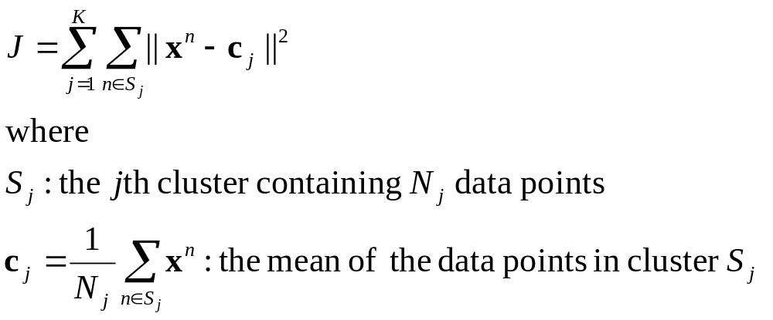
K-means clustering algorithm
The algorithm partitions data points into K disjoint subsets.
The clustering criteria are:
- the cluster centers are set in the high density regions of data
- a data point is assigned to the cluster with which it has the minimum distance to the center
Mathematically, this is equivalent to minimizing the sum-of-square clustering function,
Notes:
See 1D, and 2D examples.

Slide 32
K-means clustering algorithm
Step 1: Initially randomly assign data points to one of K clusters. Each data points will then have a cluster label.
Step 2: Calculate the mean of each cluster C.
Step 3: Check whether each data pointed has the right cluster label.
For each data point, calculate its distances to all K centers. If the minimum distance is not the value for this data point to its cluster center, the cluster identity of this data point will then be updated to the one that gives the minimum distance.
Step 4: After each epoch checking (one turn for all data points), if no updating occurs, i.e, J reaches the minimum value, then stop. Otherwise, go back to step 2.

Slide 33
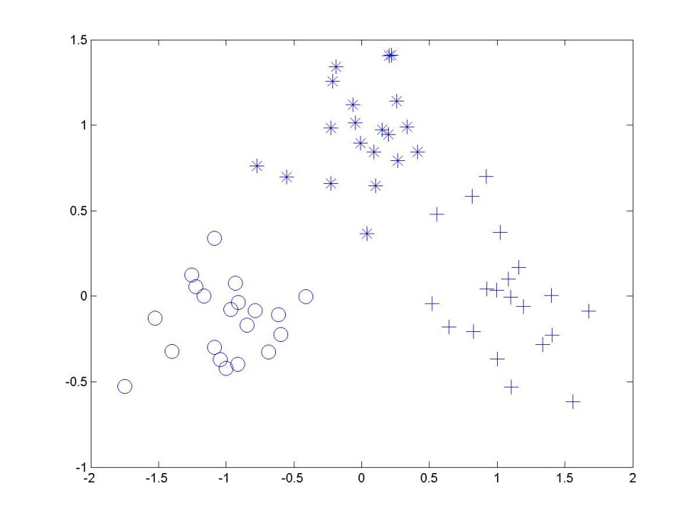
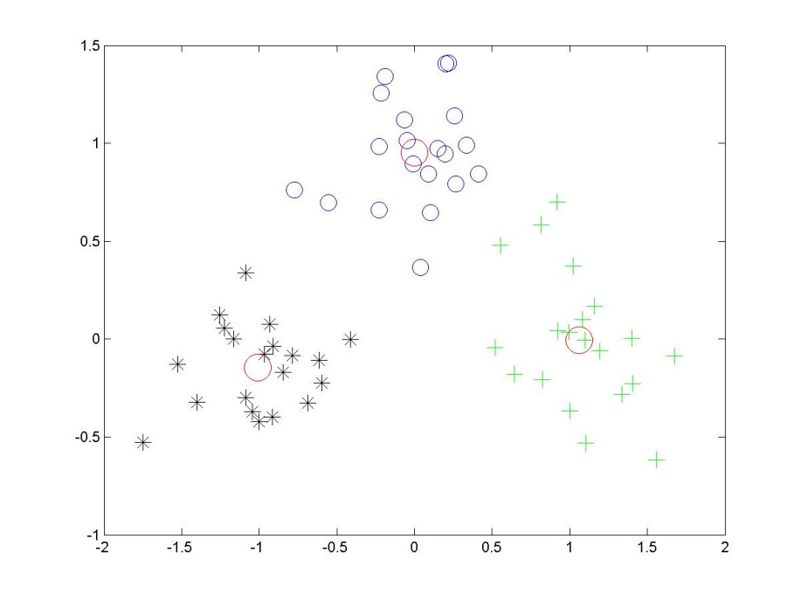
An example of data clustering
_{Before clustering}
_{After clustering}

Slide 34
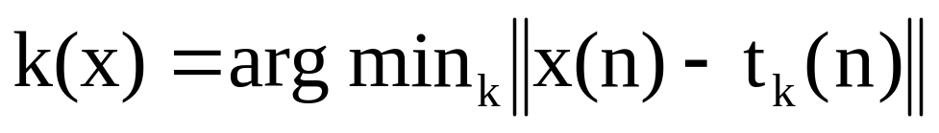
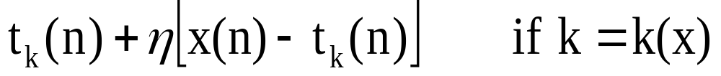
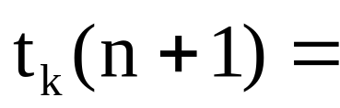
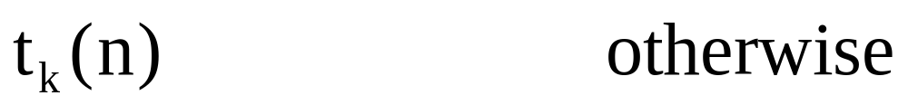
K-means clustering algorithm for centers
  Initialization: t_{k}(0) random k = 1, …, m₁
  Sampling: draw x from input space C
  Similarity matching: find index of best center
  Updating: adjust centers
  Continuation: increment n by 1, goto 2 and continue until no noticeable changes of centers occur

Slide 35
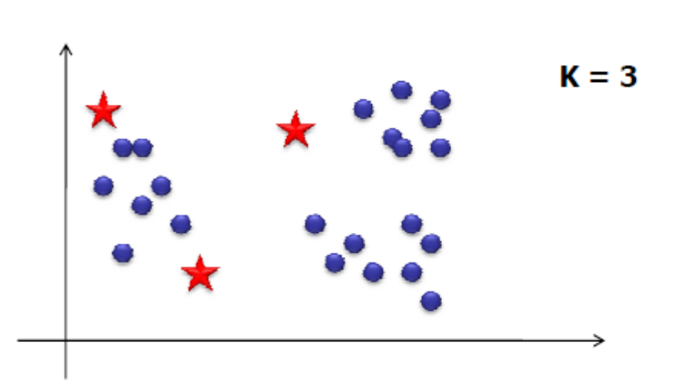
K-means algorithm description
  Choose the number of clusters, K
  Randomly choose initial positions of K centroids
  Assign each of the points to the “nearest centroid” (depends on distance measure)

Slide 36
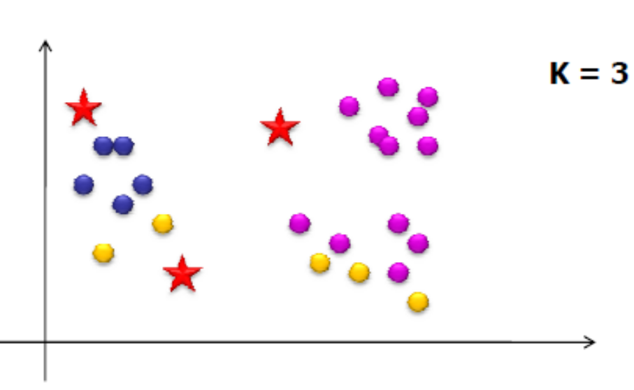
K-means algorithm description
  Choose the number of clusters - K
  Randomly choose initial positions of K centroids
  Assign each of the points to the “nearest centroid” (depends on distance measure)

Slide 37
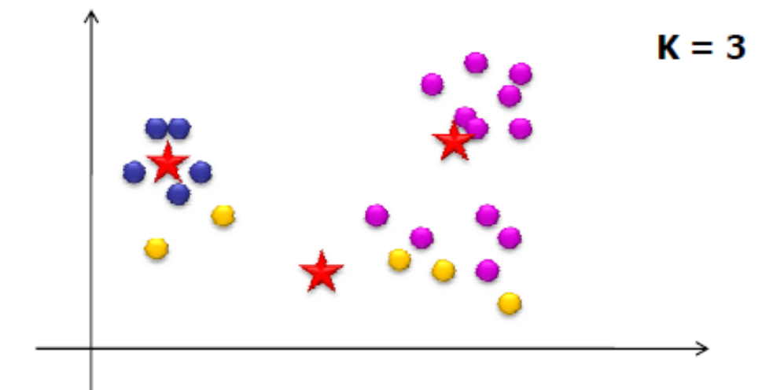
K-means algorithm description
  Choose the number of clusters - K
  Randomly choose initial positions of K centroids
  Assign each of the points to the “nearest centroid” (depends on distance measure)
  Re-compute centroid positions
  If solution converges → Stop!

Slide 38
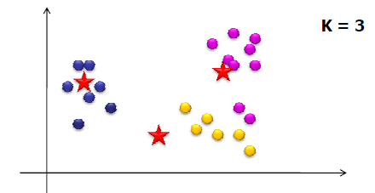
K-means algorithm description
  Choose the number of clusters - K
  Randomly choose initial positions of K centroids
  Assign each of the points to the “nearest centroid” (depends on distance measure)
  Re-compute centroid positions
  If solution converges → Stop!

Slide 39
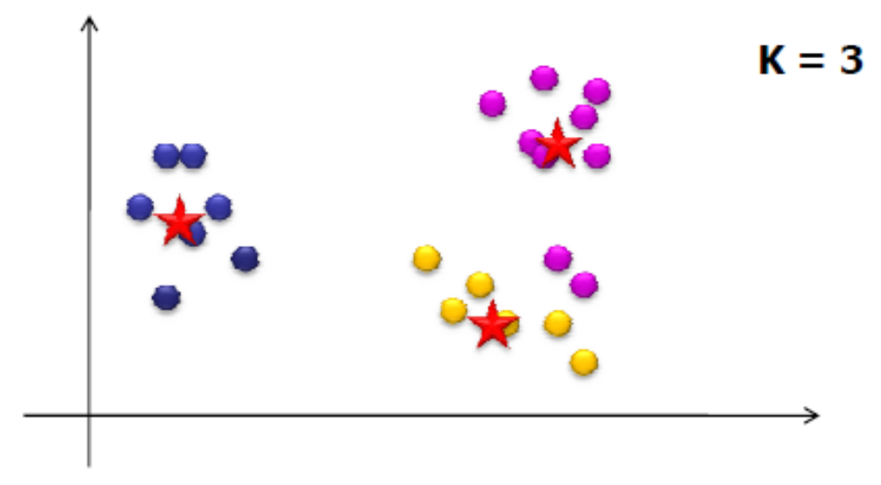
K-means algorithm description
  Choose the number of clusters - K
  Randomly choose initial positions of K centroids
  Assign each of the points to the “nearest centroid” (depends on distance measure)
  Re-compute centroid positions
  If solution converges → stop!

Slide 40
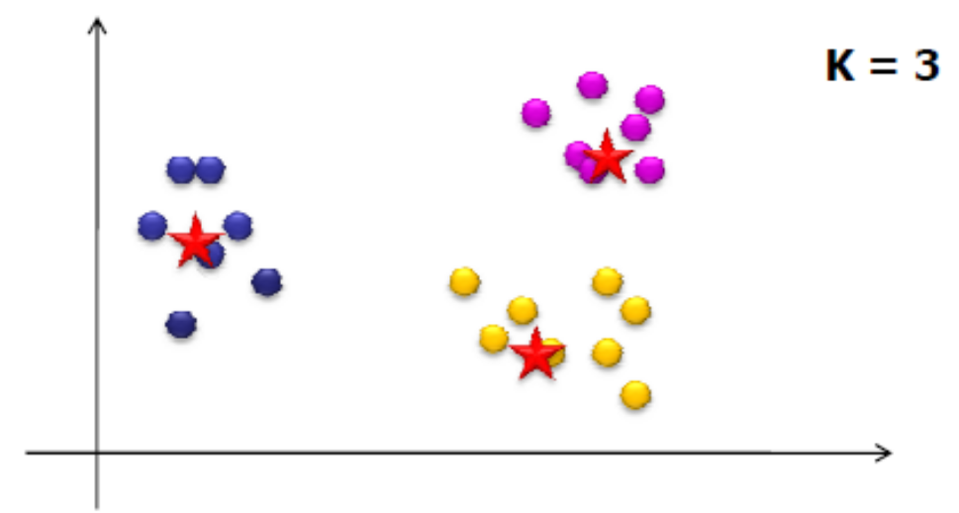
K-means algorithm description
  Choose the number of clusters - K
  Randomly choose initial positions of K centroids
  Assign each of the points to the “nearest centroid” (depends on distance measure)
  Re-compute centroid positions
  If solution converges → Stop!

Slide 41
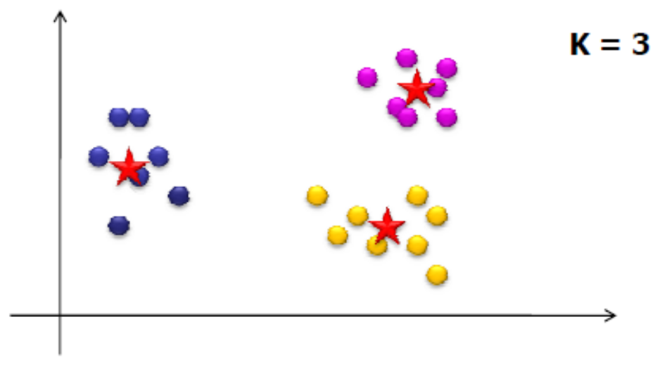
K-means algorithm description
  Choose the number of clusters - K
  Randomly choose initial positions of K centroids
  Assign each of the points to the “nearest centroid” (depends on distance measure)
  Re-compute centroid positions
  If solution converges →Stop!

Slide 42
K-means using Matlab
Doing K-means in Matlab is simple:
[cidx2,cmeans2] = kmeans(meas,2);
The cluster
index each
sample
belongs to
The clusters
centorids
The data
K
By default kmeans
uses squared
Euclidian distance

Slide 43
K-means using Matlab
Displaying the algorithm iterations
[cidx2,cmeans2]=kmeans(meas,2,'display','iter');
iter phase num sum
1 1 150 615.104
2 1 27 421.975
3 1 32 270.577
4 1 19 195.266
5 1 11 157.738
6 1 3 152.348
7 2 0 152.348
7 iterations, total sum of distances = 152.348

Slide 44
K-means using Matlab
Increasing the number of clusters
>>[cidx3,cmeans3]=kmeans(meas,3,'display','iter');
iter phase num sum
1 1 150 147.9
2 1 4 145.177
3 1 4 143.924
4 1 3 143.61
5 1 1 143.542
6 1 2 143.414
7 1 2 143.023
8 1 2 142.823
9 1 1 142.786
10 1 1 142.754
11 2 1 142.754
11 iterations, total sum of distances = 142.754

Slide 45
RBF Networks vs. MLP
Similarities
  The RBF Networks and the MLP are layered feedforward networks that produce nonlinear function mappings;
  They are both proven to be universal approximators;
Differences
  An RBF network has only one hidden layer, while MLP networks have one or more hidden layers depending on the application task;
  The nodes in the hidden and output layers of MLP use the same activation function, while RBF uses different activation functions at each node (Gaussians parameterized by different centers and variances);
  The hidden and output layers of MLP are both nonlinear, while only the hidden layer of RBF is nonlinear ( the output layer is linear );
  The activation functions in the RBF nodes compute the Euclidean distance between the input examples and the centers, while the activation functions of MLP compute inner products from the input examples and the incoming weights;
  MLP constructs global approximations while RBF construct local approximations.

Slide 46
RBF Networks vs. Multilayer Perceptrons
RBF is a local model
Fast learner
Not so good at high dimension spaces
MLPs are global models that response to all the data
Slow learners
Insensitive to the curse of dimensionality

Slide 47
Implementing Radial - Basis Function Networks
1. The XOR Example
Consider the XOR
example:
(x₁,x₂) | Y
------------
(0, 0) | 0
(0, 1) | 1
(1, 0) | 1
(1, 1) | 0
The XOR example can be
learned by an RBF network with
the following structure
- two hidden nodes and one output node;
the output unit has a bias term b, that is the mapping is: F( x ) =∑_{i=1}² w_{i} exp( - || x - x_{i} ||2 / 2σ_{i}² ) + b
Solution: Training of this RBF to learn the XOR examples involves the following steps

Slide 48
RBF network for the XOR problem
Initialization:
the network structure has two basis functions φ₁
and φ₂
φ₁ = exp(-||x - x₁ ||² ) and φ₂ = exp(-||x - x₂ ||² )
- the centers are: x₁ = (1,1) and x₂ = (0,0)
the basis are assumed to be one:
σ₁² = 1 and σ₂² = 1

Slide 49
Training:
φ₁₁ = exp( -(( 0-1 )²+( 0-1 )² )) = exp( -2 ) = 0.1353
φ₂₁ = exp( -(( 0-1 )²+( 1-1 )² )) = exp( -1 ) = 0.3678
φ₃₁ = exp( -(( 1-1 )²+( 0-1 )² )) = exp( -1 ) = 0.3678
φ₄₁ = exp( -(( 1-1 )²+( 1-1 )² )) = exp( 0 ) = 1
φ₁₂ = exp( -(( 0-0 )²+( 0-0 )² )) = exp( 0 ) = 1
φ₂₂ = exp( -(( 0-0 )²+( 1-0 )² )) = exp( -1 ) = 0.3678
φ₃₂ = exp( -(( 1-0 )²+( 0-0 )² )) = exp( -1 ) = 0.3678
φ₄₂ = exp( -(( 1-0 )²+( 1-0 )² )) = exp( -2 ) = 0.1353

Slide 50
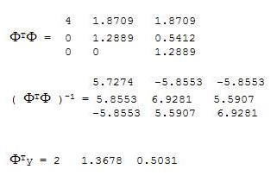
w₀ = 0.5
w₁ = 0.578235
w₂ = -0.578236

Slide 51
References
http://www.obgyn.cam.ac.uk/cam-only/statsbook/stneunet.html
Neural Networks for Pattern Recognition by Christopher M. Bishop , Oxford University Press, Oxford UK , 1995. (more advanced - graduate level)

